Slide 1
edge payments
©2019 Oveit, Inc. Proprietary and Confidential

Slide 2
Oveit is a fintech company developing edge payments technology.
We build decentralized payment solutions that increase payments capacity 10x.
We think we are the PC moment for the payments industry.
©2019 Oveit, Inc. Proprietary and Confidential

Slide 3
So … why?
Magic happens in the cloud
We swipe our cards
We buy stuff
This is how we imagine payments work
©2019 Oveit, Inc. Proprietary and Confidential

Slide 4
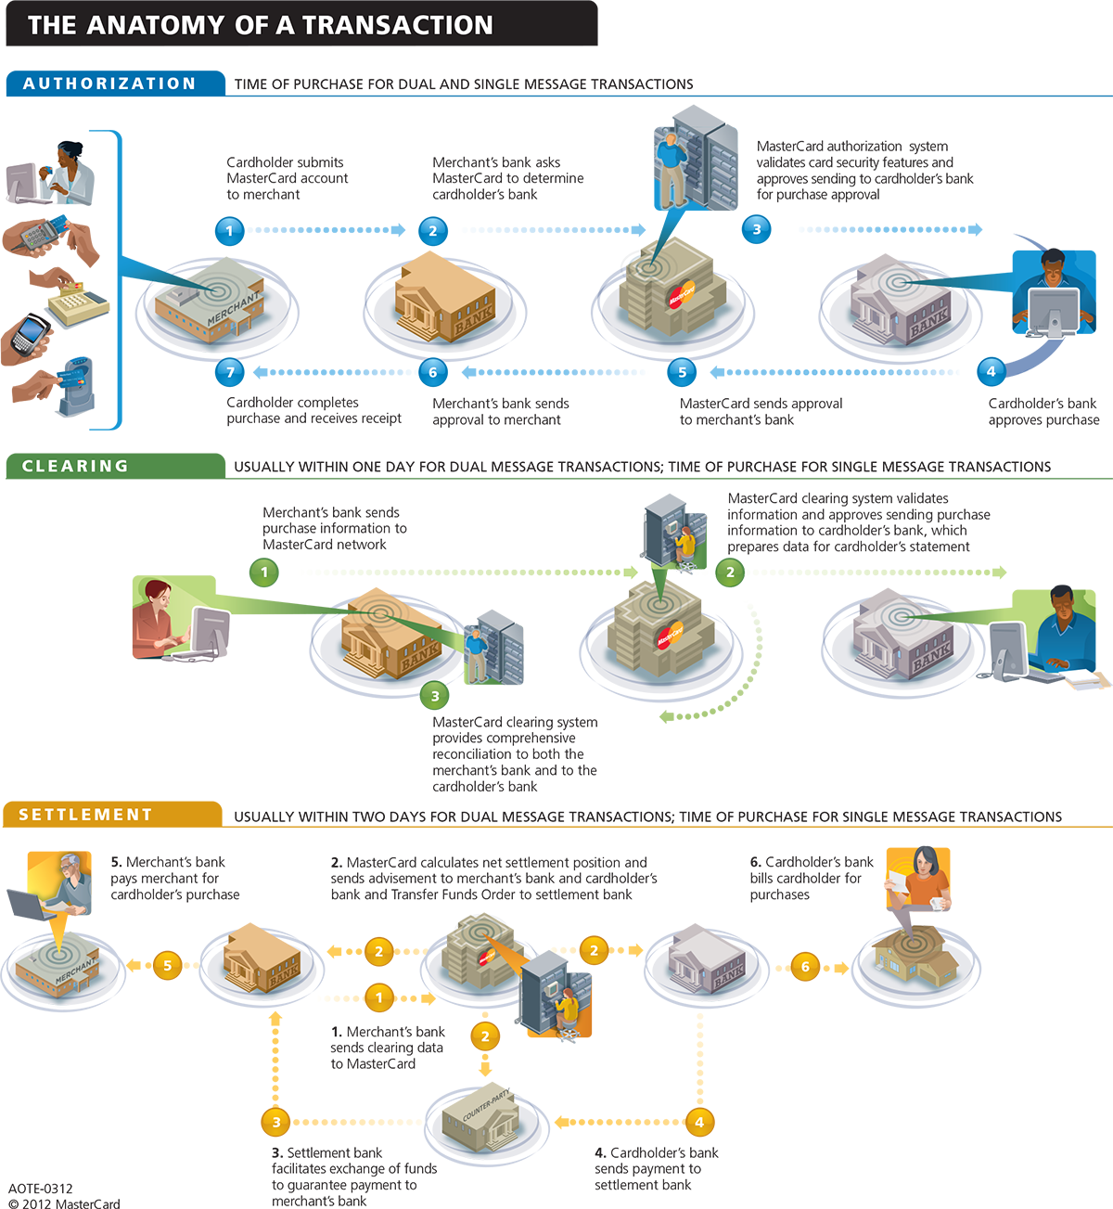
This is how they actually work
Source: MasterCard https://www.youtube.com/watch?v=zgq4FvrIOe0
©2019 Oveit, Inc. Proprietary and Confidential

Slide 5
Card data travels thousands of miles through multiple servers and services...
… So we can buy an item right next to us.
Do you think that can be a problem?
©2019 Oveit, Inc. Proprietary and Confidential

Slide 6
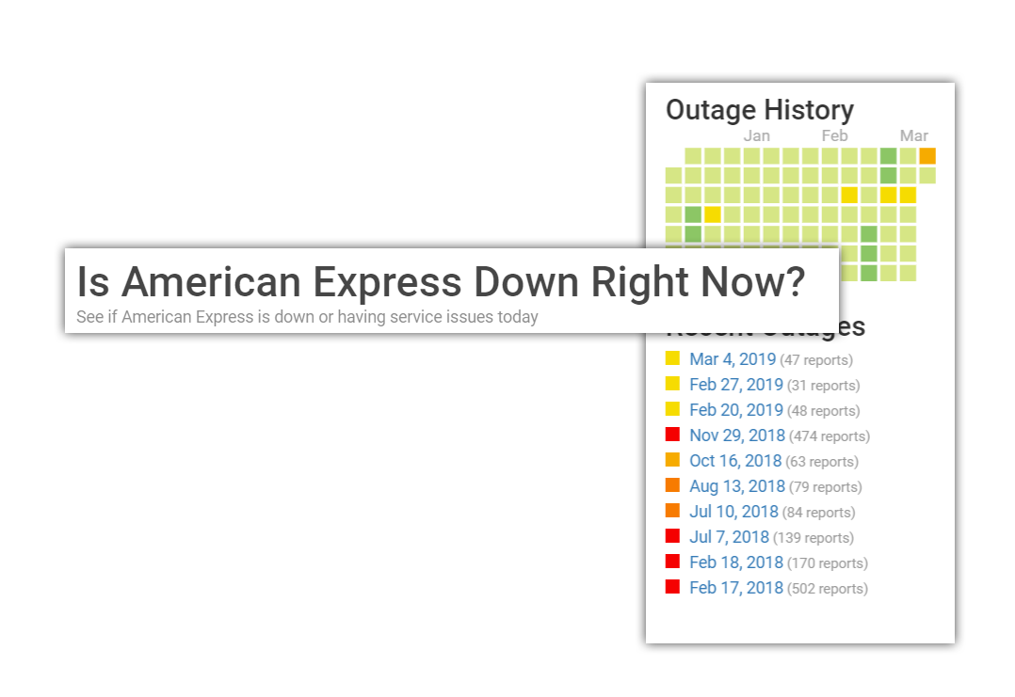
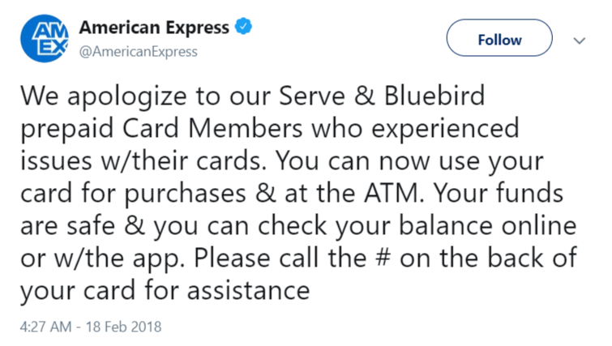
©2019 Oveit, Inc. Proprietary and Confidential

Slide 7
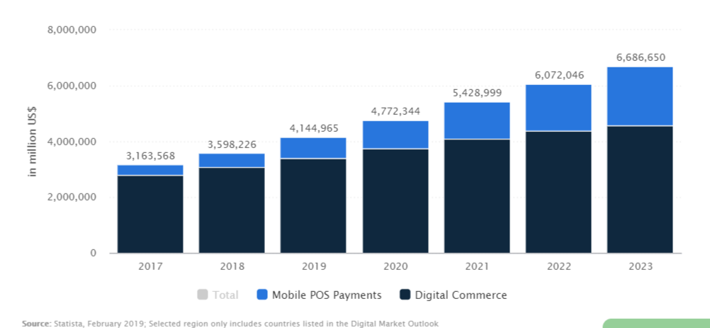
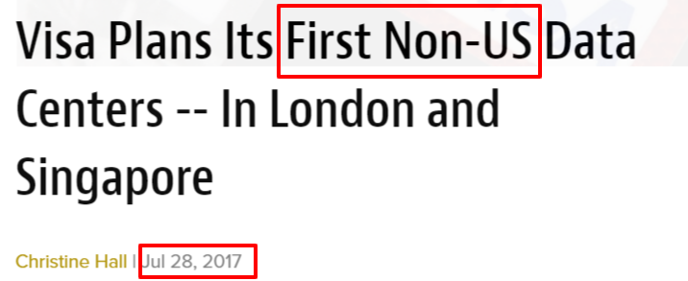
Why is this happening?
1
2
https://www.datacenterknowledge.com/asia-pacific/visa-plans-its-first-non-us-data-centers-london-and-singapore
The payment infrastructure is over - centralized and overworked.
Demand for digital payments is growing fast
©2019 Oveit, Inc. Proprietary and Confidential

Slide 8
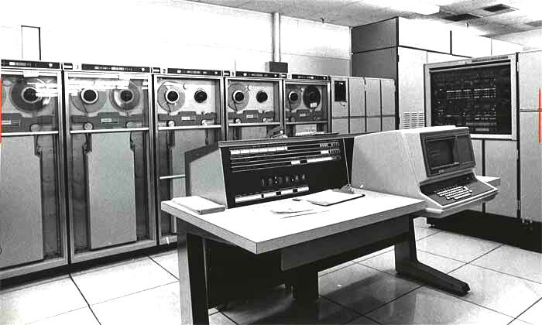
Mainframe computing 30 years ago.
“Cloud” payments now.
The payments industry is stuck with the idea of mainframe computing.
With 22 bln. IOT (Internet of Things) devices in 2025, that just won’t work anymore.
©2019 Oveit, Inc. Proprietary and Confidential

Slide 9
Oveit moves payments at the edge of the cloud, where they actually happen. 1. save 90% of transactions workload, 2. increase revenue 30 to 60% 3. get valuable data insights in consumer behavior.
©2019 Oveit, Inc. Proprietary and Confidential

Slide 10
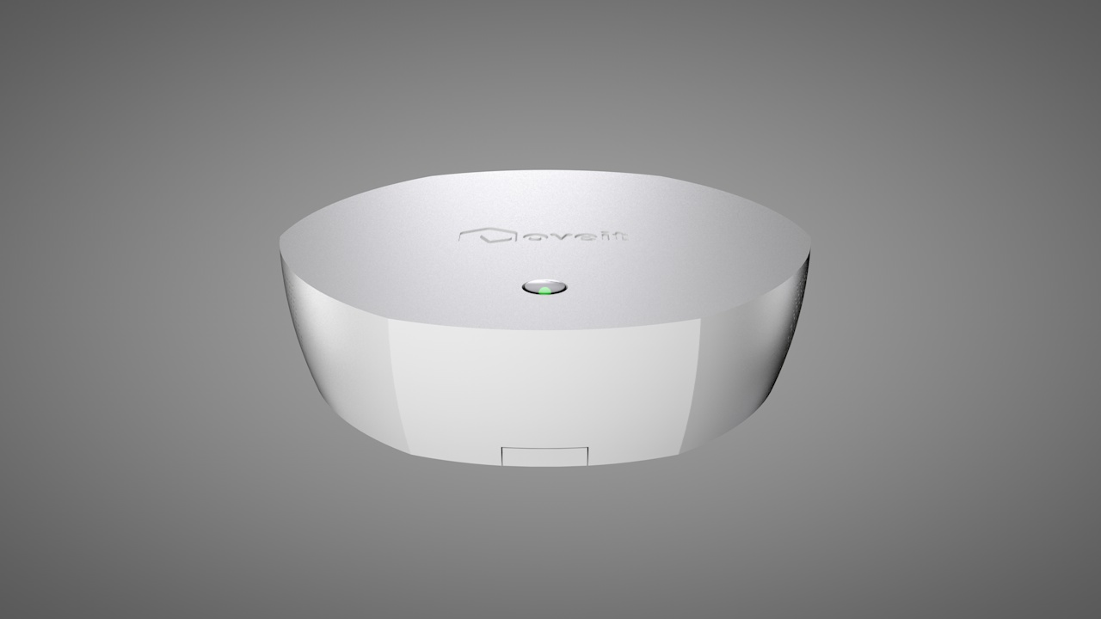
Facial recognition and advanced biometrics for liveliness detection
Distributed ledgers for local payment processing
Good things come in small packages
Fraud detection and prevention
Data redundancy
Security
Personalization and prediction
Smart contracts for local payment networks
Our solution runs on secured IoT devices designed for reliability and speed.
©2019 Oveit, Inc. Proprietary and Confidential

Slide 11
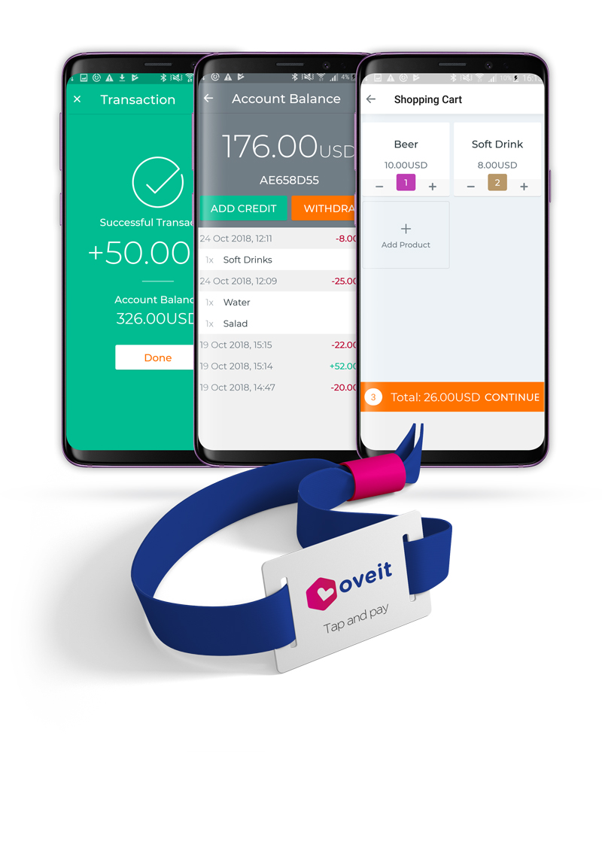
No more complicated hardware and software. Mobile first.
Connect customers to vendors
Control over payments
Always working. No downtime.
©2019 Oveit, Inc. Proprietary and Confidential

Slide 12
The biggest stadium in Nederlands uses our tech: facial recognition for biometric payments
©2019 Oveit, Inc. Proprietary and Confidential

Slide 13
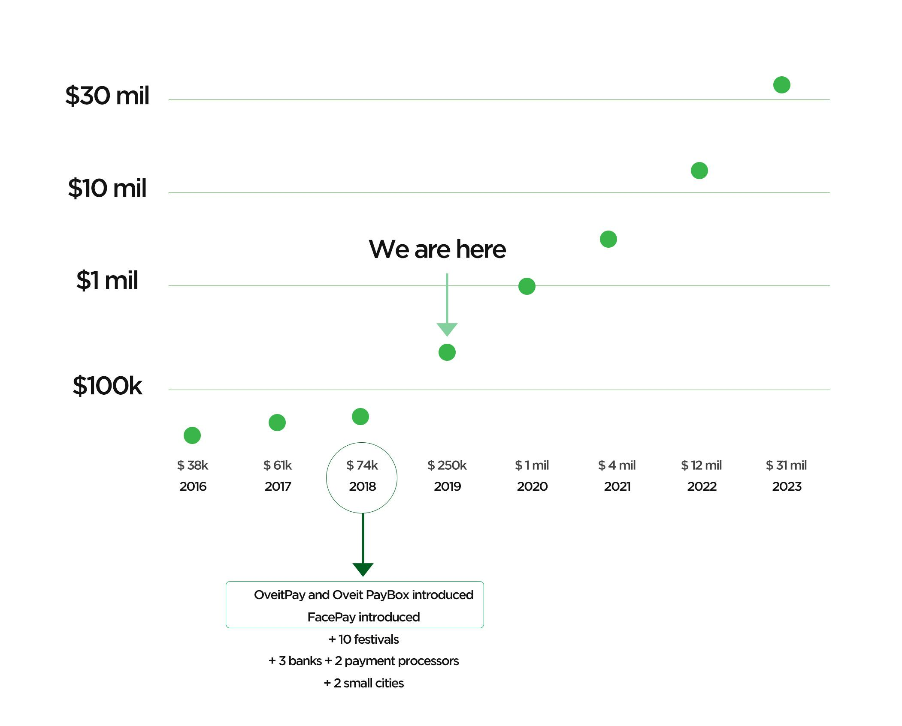
Traction & Projections
Net revenue
©2019 Oveit, Inc. Proprietary and Confidential

Slide 14
Customers’ feedback
Customers and partners
“All the features you need in one place!”
“Great app, stellar customer support”
“Oveit's bespoke around the clock support made it possible!”
©2019 Oveit, Inc. Proprietary and Confidential

Slide 15
Viral marketing model
We sell B2B
B2B customers request our payment system
End users pay with Oveit. They love the experience. (ex: Amsterdam Arena has 50 000 visitors per match)
Businesses implement our system in their processes
©2019 Oveit, Inc. Proprietary and Confidential

Slide 16
Freemium revenue model
Free
Pro + Enterprise
Free event management app
Transaction fees
Setup fees
Subscription fees
Dedicated support
©2019 Oveit, Inc. Proprietary and Confidential

Slide 17
Market
$8.3 trillion
Smart Cities
We have started in the event and venues market and we plan on bringing our technology where it can provide the most benefits:
✓ Tourism and travel
✓ Retail
✓ Smart cities
$4.4 trillion
Retail Chains
$2.6 trillion
Tourism & Travel
$45 billion
Events & Venues
©2019 Oveit, Inc. Proprietary and Confidential
Size
Source: Statista.com and Deloitte.com; Retail Chains = Top250 retailers

Slide 18
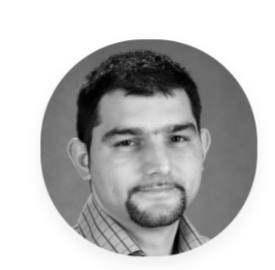
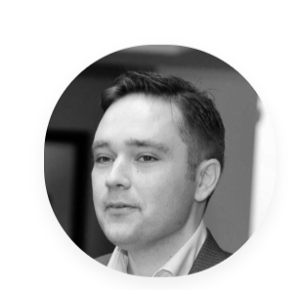
Management Team
Andrei Stefan (founder)
CEO
Mr. Stefan has an Executive Education from Harvard University, a Master in Business Administration from Rice University, and a Bachelor’s Degree in Law & International Relationships from Bucharest University.
Mr. Stefan is specialized in management, finance and team building. He has expertise in both start-up companies and corporations with over 1,000 employees and over $100 million in revenue. Mr. Stefan has received awards in operational excellence and technology creation from both the academic and corporate bodies. He has over 15 years in leading technology driven companies on several industries.
Mike Dragan (co-founder)
COO
Mr. Dragan has a Postgraduate Degree in Artificial Intelligence, a Master in Data Management and two Bachelor’s Degrees in Computer Engineering with specialization in Artificial Neural Networks, respectively in Economic Studies with specialization in Digital Marketing from prestigious European and American academic institutions.
Mr. Dragan is specialized in digital development and artificial intelligence. He has received over 30 awards in his professional career in digital design and technology innovation. Mr. Dragan has over 10 years’ experience in information technology and digital development.
©2019 Oveit, Inc. Proprietary and Confidential

Slide 19
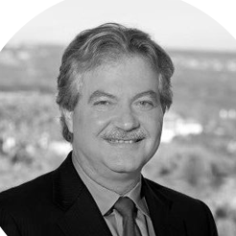
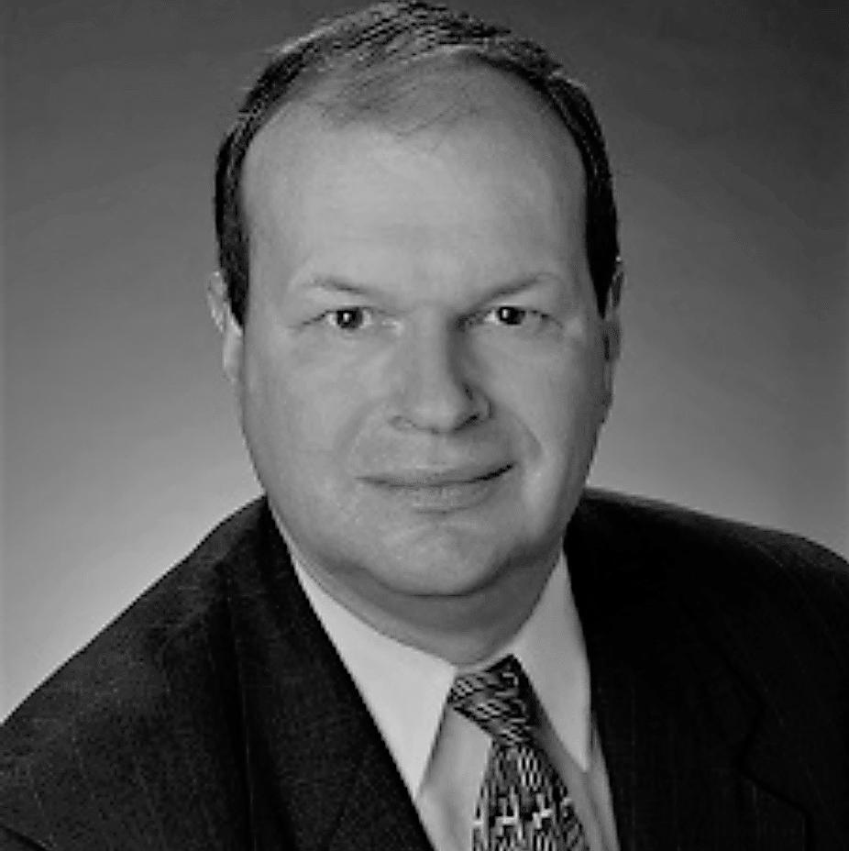
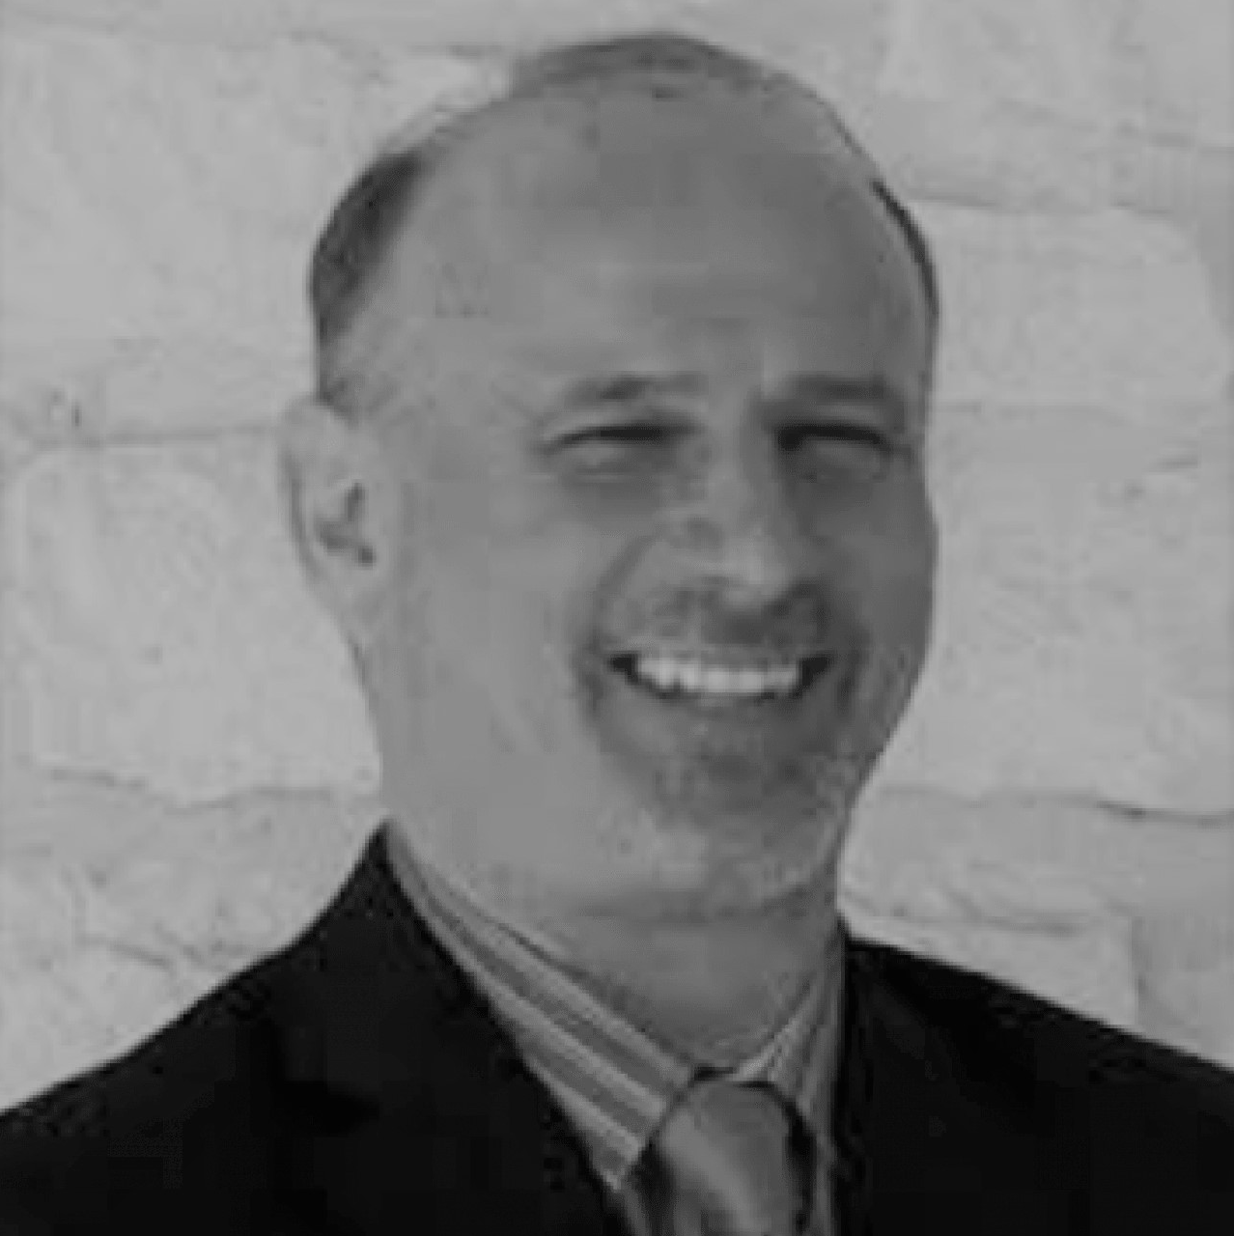
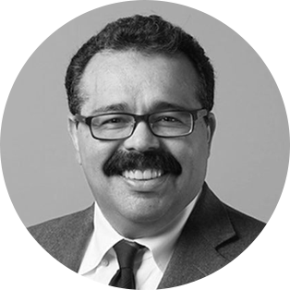
Board of Advisors and Counsel
Angelos Angelou
Founder & CEO at Angelou Economics
Expert on technology-based economic development, business accelerator programs, and Angel Investing. Mr. Angelou specializes in strategic business planning and development, corporate site selection, incentives negotiation, economic research and analysis, and entrepreneurial accelerator programs. Mr. Angelou’s comments and insights are regularly sought by the national and international media.
David Smith
Expert on Wicked Problem Solver
One of the seven top global futurists in the Millennium issue of Businessweek feature, “What Technology Will Be Like in 100 Years”. Mr. Smith co-led the first-ever US industry wide roadmap to chart the United States regaining the lead in the semiconductor industry and was one of the principal designers and architects at In-Q-Tel. Mr. Smith has served as CEO and President in various technology companies.
Carl J. Mehlman
Partner at TMV Business Group
After an accomplished 30-year career leading private start-ups and diverse public businesses to great achievement, consistently growing revenue and delivering strong profitability, Carl launched his second career, devoted to serving others. Carl initially chose “7 Mindsets”, a personal development and educational program, as the foundation of his mission to inspire individuals to lead happier and more successful lives.
Carmelo Gordian
Partner at Shearman & Sterling LLP
Major Investor, BOD, Harvard Law School graduate, has practiced corporate and securities law for 25+ years. Known as a leader in the Texas venture capital and private equity community. Represents over 70 large funds around the world, and was formerly the chairman of the San Francisco - based Brobeck Business & Technology Group.
©2019 Oveit, Inc. Proprietary and Confidential

Slide 20
Competition
 | data analytics | entrance check-in | e-ticketing payment processing | online registration | receive instant ticket sales | blockchain secure transactions | offline transactions | digital wallets | NFC payments | smart access badges & wristbands | Biometrics / facial recognition
 | ✓ | ✓ | ✓ | ✓ | ✗ | ✗ | ✗ | ✗ | ✗ | ✗ | ✗
 | ✓ | ✓ | ✓ | ✓ | ✗ | ✗ | ✗ | ✗ | ✗ | ✗ | ✗
 | ✓ | ✓ | ✓ | ✓ | ✗ | ✗ | ✗ | ✗ | ✗ | ✓ | ✗
 | ✓ | ✓ | ✓ | ✓ | ✓ | ✓ | ✓ | ✓ | ✓ | ✓ | ✓
 | ✓ | ✓ | ✗ | ✗ | ✗ | ✗ | ✗ | ✗ | ✓ | ✓ | ✗
 | ✓ | ✓ | ✗ | ✗ | ✗ | ✗ | ✗ | ✓ | ✓ | ✓ | ✗
 | ✓ | ✗ | ✗ | ✗ | ✗ | ✗ | ✓ | ✓ | ✓ | ✓ | ✗
Event Management
Vendor Ecosystem
©2019 Oveit, Inc. Proprietary and Confidential

Slide 21
We are raising
pre-series A
SAFE
Andrei Stefan
CEO
andrei@oveit.com
Mike Dragan
COO
mike@oveit.com
oveit.com
International Accelerator
8121 Bee Cave Road, Suite 200
Austin, Texas 78746
facebook.com/oveitcom twitter.com/oveitcom linkedin.com/company/Oveit
US: +1 650 319 7337

Slide 22
Explore our technology. Click to play video.
Vendor ecosystems
FacePay (biometric payments using facial recognition)

