Slide 1
$
$
$
$
$
Notes:
1.Hi….. I’m Vasile, from Beez, one of Fastest Growing, startup THAT POSITIVELY impacts consumers and merchants alike

Slide 2
Opportunity
$
$
$
E-commerce is growing exponentially,leaving consumer financing behind
Beez is issuing credit at the point of sale, using Data Driven decision, for one click users experience, impacting a 1.3T $ industry

Slide 3
Problem
$
$
- 22.00% Interest on Cash Back Credit Cards
-30.00% penalty if you don’t pay on time
- annual fees, and commissions
People get credit cards ….. but….don’t fully understand how they work, or who much they cost and they end up paying more

Slide 4
Solution
$
$
$
Our approach is to eliminate the bank from, give users access to buy now pay later shopping model, and support de financing cost directly from the retailer.

Slide 5
Our Product
$
$
$
Spending benefits (Cashback)
Automated saving solution
Credit with: NO interest, NO late fees, NO commissions

Slide 6
$
$
$
How we do it
Our Users
Buy the product Now, Pay in 60 Days
Cashback in over 500 stores (from 2 to 15%)
Price drop Guarantee (30 days)
Altex 5%
1. Pay back 1000 lei in up to 60 days later
2. You save 50 lei in you Beez account
3. If the product price goes on promotion you get the difference instant in beez account
Buy a product for 1000

Slide 7
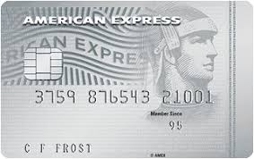
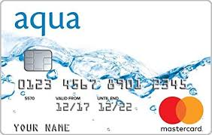
Competition
$
$
$
Tier ONE :
Klarna
Mainly B2B payment processing oriented
Tier TWO:
Reward credit Card From traditional issuers
American Express Platinum Cashback Everyday
Blue Cash Preferred from American Express
Chase Sapphire Preferred
Santander All in One Credit Card,
Aqua Reward Credit Card
…………..

Slide 8
Market Size
$
$
$
We target US AND UK markets
US - $1 Trillion UK - £220 Billion
Both of these segments are extracted from the total volume of the credit card transactions in that market, by taking into considerations the 33% which represents the online credit card shopping

Slide 9
Customer Acquisition
$
$
$
At this time the cost for user acquisition are
0,5 euro / user
18 euro / active user
Influencers / bloggers
We will begin with financial education advocates and personal development teachers, but also fashion bloggers.
Social Media ADS
20 % organic growth

Slide 10
Business Model
$
$
$
2 Revenue Strings
Cashback Channel + 0,7-3% /Transaction
BeezPay + 5-10% /Transaction + cashback (0,7-3%)
Total transaction Volume
Aprilie 2019
Total transaction Volume
Aprilie 2020
2,5 mil EUR
60% made in last 3 months
30 mil euro

Slide 11
Team
$
$
Mihai
Frontend
Developer
Dragos
Mobile
Developer
$
Lucian
COO
Doru
Backend
Developer
David
Dev Team Management
Ramona
Backend developer
Karles
CTO
Laurentiu
Customer Care
Vasile
CEO
Adriana
Content & PPC
Sorana
Graphic Designer
Mirela
Video Content

Slide 12
Our status - 10 months old
$
$
$
400.000 € Invested
21.000 €/mo Burn rate
+2.500.000 € in transaction
Results
Partner Retailers
RO-500
EU - 4700
UK - 200
DAILY
ACTIVE
USERS
1.800
Rating in Google Play
4.8
USERS
78.000
Notes:
8. This is our results after 8 months (5 sec break)

